Slide 1
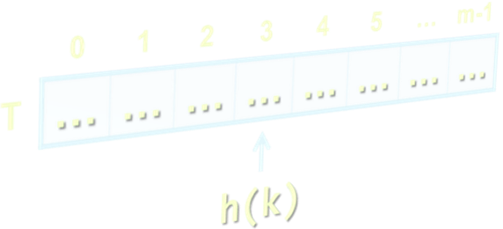
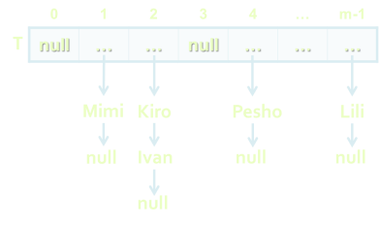

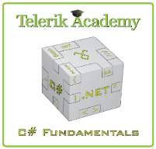

Dictionaries, Hash Tables and Sets
Dictionaries, Hash Tables, Hashing, Collisions, Sets
Data Structures and Algorithms
Telerik Software Academy
http://academy.telerik.com

Slide 2
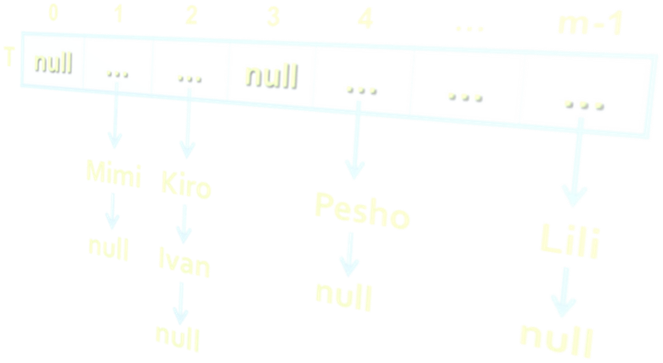

Table of Contents
Dictionaries
Hash Tables
Dictionary<TKey, TValue> Class
Sets: HashSet<T> and SortedSet<T>

Slide 3
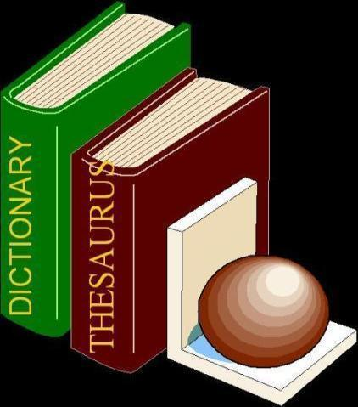

Dictionaries
Data Structures that Map Keys to Values

Slide 4
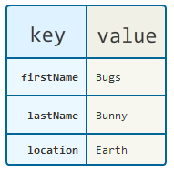
The Dictionary (Map) ADT
The abstract data type (ADT) "dictionary" maps key to values
Also known as "map" or "associative array"
Contains a set of (key, value) pairs
Dictionary ADT operations:
Add(key, value)
FindByKey(key) → value
Delete(key)
Can be implemented in several ways
List, array, hash table, balanced tree, ...

Slide 5
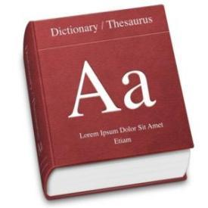
ADT Dictionary – Example
Example dictionary:
Key | Value
C# | Modern object-oriented programming language for the Microsoft .NET platform
CLR | Common Language Runtime – execution engine for .NET assemblies, integral part of .NET Framework
compiler | Software that transforms a computer program to executable machine code
… | …

Slide 6
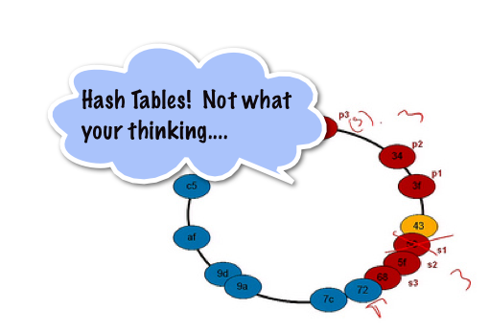
Hash Tables
What is Hash Table? How it Works?

Slide 7
Hash Table
A hash table is an array that holds a set of (key, value) pairs
The process of mapping a key to a position in a table is called hashing
0 | 1 | 2 | 3 | 4 | 5 | … | m-1
T
… | … | … | … | … | … | … | …
Hash function h: k → 0 … m-1
h(k)
Hash table of size m

Slide 8
Hash Functions and Hashing
A hash table has m slots, indexed from 0 to m-1
A hash function h(k) maps keys to positions:
h: k → 0 … m-1
For any value k in the key range and some hash function h we have h(k) = p and 0 ≤ p < m
0 | 1 | 2 | 3 | 4 | 5 | … | m-1
T
… | … | … | … | … | … | … | …
h(k)

Slide 9
Hashing Functions
Perfect hashing function (PHF)
h(k) : one-to-one mapping of each key k to an integer in the range [0, m-1]
The PHF maps each key to a distinct integer within some manageable range
Finding a perfect hashing function is in most cases impossible
More realistically
Hash function h(k) that maps most of the keys onto unique integers, but not all

Slide 10

Collisions in a Hash Table
A collision is the situation when different keys have the same hash value
h(k₁) = h(k₂) for k₁ ≠ k₂
When the number of collisions is sufficiently small, the hash tables work quite well (fast)
Several collisions resolution strategies exist
Chaining in a list
Using the neighboring slots (linear probing)
Re-hashing (second hash function)
...

Slide 11

Collision Resolution: Chaining
h("Pesho") = 4
h("Kiro") = 2
h("Mimi") = 1
h("Ivan") = 2
h("Lili") = m-1
Chaining elements in case of collision
collision
0 | 1 | 2 | 3 | 4 | … | m-1
T
null | … | … | null | … | … | …
Mimi
Kiro
Pesho
Lili
null
Ivan
null
null
null

Slide 12
Hash Tables and Efficiency
Hash tables are the most efficient implementation of ADT "dictionary"
Add / Find / Delete take just few primitive operations
Speed does not depend on the size of the hash-table (constant time)
Amortized complexity O(1)
Example: finding an element in a hash-table with 1 000 000 elements, takes just few steps
Finding an element in array of 1 000 000 elements takes average 500 000 steps

Slide 13
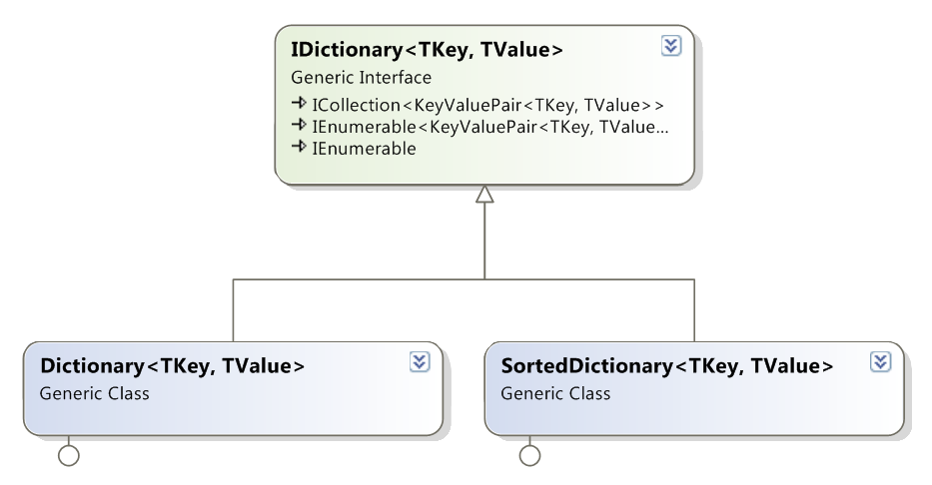
Dictionaries: .NET Interfaces and Implementations

Slide 14

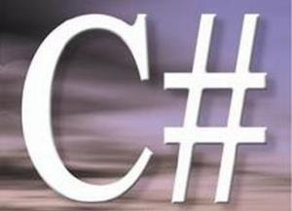
Hash Tables in C#
The Dictionary<TKey,TValue> Class

Slide 15
Dictionary<TKey,TValue>
Implements the ADT dictionary as hash table
The size is dynamically increased as needed
Contains a collection of key-value pairs
Collisions are resolved by chaining
Elements have almost random order
Ordered by the hash code of the key
Dictionary<TKey,TValue> relies on
Object.Equals() – for comparing the keys
Object.GetHashCode() – for calculating the hash codes of the keys

Slide 16
Dictionary<TKey,TValue> (2)
Major operations:
Add(TKey,TValue) – adds an element with the specified key and value
Remove(TKey) – removes the element by key
this[] – get / add / replace of element by key
Clear() – removes all elements
Count – returns the number of elements
Keys – returns a collection of the keys
Values – returns a collection of the values

Slide 17
Dictionary<TKey,TValue> (3)
Major operations:
ContainsKey(TKey) – checks whether the dictionary contains given key
ContainsValue(TValue) – checks whether the dictionary contains given value
Warning: slow operation – O(n)
TryGetValue(TKey, out TValue)
If the key is found, returns it in the TValue
Otherwise returns false

Slide 18

Dictionary<TKey,TValue> – Example
Dictionary<string, int> studentsMarks =
new Dictionary<string, int>();
studentsMarks.Add("Ivan", 4);
studentsMarks.Add("Peter", 6);
studentsMarks.Add("Maria", 6);
studentsMarks.Add("George", 5);
int peterMark = studentsMarks["Peter"];
Console.WriteLine("Peter's mark: {0}", peterMark);
Console.WriteLine("Is Peter in the hash table: {0}",
studentsMarks.ContainsKey("Peter"));
Console.WriteLine("Students and grades:");
foreach (var pair in studentsMarks)
{
Console.WriteLine("{0} --> {1}", pair.Key, pair.Value);
}

Slide 19


Dictionary<TKey,TValue>
Live Demo

Slide 20
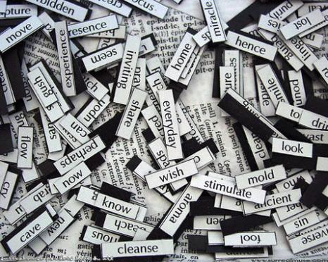
Counting the Words in a Text
string text = "a text, some text, just some text";
IDictionary<string, int> wordsCount =
new Dictionary<string, int>();
string[] words = text.Split(' ', ',', '.');
foreach (string word in words)
{
int count = 1;
if (wordsCount.ContainsKey(word))
count = wordsCount[word] + 1;
wordsCount[word] = count;
}
foreach(var pair in wordsCount)
{
Console.WriteLine("{0} -> {1}", pair.Key, pair.Value);
}

Slide 21

Counting the Words in a Text
Live Demo

Slide 22
Nested Data Structures
Data structures can be nested, e.g. dictionary of lists: Dictionary<string, List<int>>
static Dictionary<string, List<int>> studentGrades =
new Dictionary<string, List<int>>();
private static void AddGrade(string name, int grade)
{
if (! studentGrades.ContainsKey(name))
{
studentGrades[name] = new List<int>();
}
studentGrades[name].Add(grade);
}

Slide 23
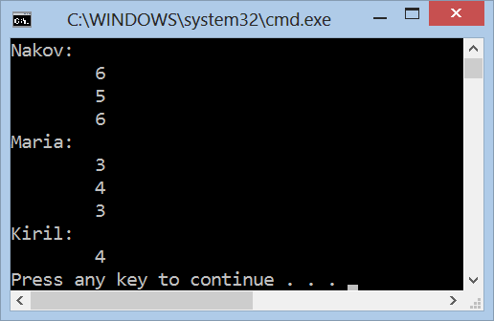
Dictionary of Lists
Live Demo

Slide 24
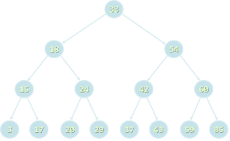

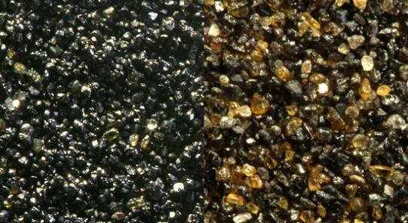
Balanced Tree Dictionaries
The SortedDictionary<TKey,TValue> Class

Slide 25
SortedDictionary <TKey,TValue>
SortedDictionary<TKey,TValue> implements the ADT "dictionary" as self-balancing search tree
Elements are arranged in the tree ordered by key
Traversing the tree returns the elements in increasing order
Add / Find / Delete perform log₂(n) operations
Use SortedDictionary<TKey,TValue> when you need the elements sorted by key
Otherwise use Dictionary<TKey,TValue> – it has better performance

Slide 26
Counting Words (Again)
string text = "a text, some text, just some text";
IDictionary<string, int> wordsCount =
new SortedDictionary<string, int>();
string[] words = text.Split(' ', ',', '.');
foreach (string word in words)
{
int count = 1;
if (wordsCount.ContainsKey(word))
count = wordsCount[word] + 1;
wordsCount[word] = count;
}
foreach(var pair in wordsCount)
{
Console.WriteLine("{0} -> {1}", pair.Key, pair.Value);
}

Slide 27
Counting the Words in a Text
Live Demo

Slide 28
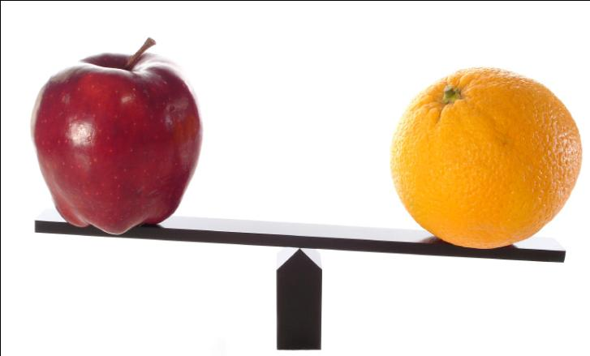
Comparing Dictionary Keys
Using custom key classes in Dictionary<TKey, TValue> and SortedDictionary<TKey,TValue>

Slide 29
IComparable<T>
Dictionary<TKey,TValue> relies on
Object.Equals() – for comparing the keys
Object.GetHashCode() – for calculating the hash codes of the keys
SortedDictionary<TKey,TValue> relies on IComparable<T> for ordering the keys
Built-in types like int, long, float, string and DateTime already implement Equals(), GetHashCode() and IComparable<T>
Other types used when used as dictionary keys should provide custom implementations

Slide 30


Implementing Equals() and GetHashCode()
public struct Point
{
public int X { get; set; }
public int Y { get; set; }
public override bool Equals(Object obj)
{
if (!(obj is Point) || (obj == null)) return false;
Point p = (Point)obj;
return (X == p.X) && (Y == p.Y);
}
public override int GetHashCode()
{
return (X << 16 | X >> 16) ^ Y;
}
}

Slide 31



Implementing IComparable<T>
public struct Point : IComparable<Point>
{
public int X { get; set; }
public int Y { get; set; }
public int CompareTo(Point otherPoint)
{
if (X != otherPoint.X)
{
return this.X.CompareTo(otherPoint.X);
}
else
{
return this.Y.CompareTo(otherPoint.Y);
}
}
}

Slide 32
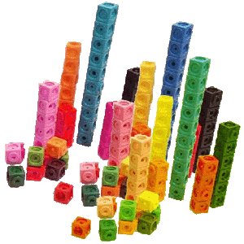

Sets
Sets of Elements

Slide 33
Set and Bag ADTs
The abstract data type (ADT) "set" keeps a set of elements with no duplicates
Sets with duplicates are also known as ADT "bag"
Set operations:
Add(element)
Contains(element) → true / false
Delete(element)
Union(set) / Intersect(set)
Sets can be implemented in several ways
List, array, hash table, balanced tree, ...

Slide 34
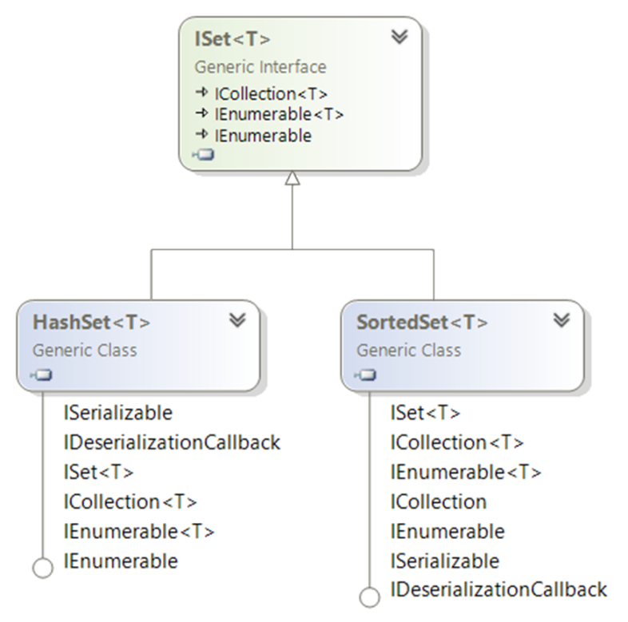
Sets: .NET Interfaces and Implementations

Slide 35
HashSet<T>
HashSet<T> implements ADT set by hash table
Elements are in no particular order
All major operations are fast:
Add(element) – appends an element to the set
Does nothing if the element already exists
Remove(element) – removes given element
Count – returns the number of elements
UnionWith(set) / IntersectWith(set) – performs union / intersection with another set

Slide 36

HashSet<T> – Example
ISet<string> firstSet = new HashSet<string>(
new string[] { "SQL", "Java", "C#", "PHP" });
ISet<string> secondSet = new HashSet<string>(
new string[] { "Oracle", "SQL", "MySQL" });
ISet<string> union = new HashSet<string>(firstSet);
union.UnionWith(secondSet);
PrintSet(union); // SQL Java C# PHP Oracle MySQL
private static void PrintSet<T>(ISet<T> set)
{
foreach (var element in set)
{
Console.Write("{0} ", element);
}
Console.WriteLine();
}

Slide 37
SortedSet<T>
SortedSet<T> implements ADT set by balanced search tree (red-black tree)
Elements are sorted in increasing order
Example:
ISet<string> firstSet = new SortedSet<string>(
new string[] { "SQL", "Java", "C#", "PHP" });
ISet<string> secondSet = new SortedSet<string>(
new string[] { "Oracle", "SQL", "MySQL" });
ISet<string> union = new HashSet<string>(firstSet);
union.UnionWith(secondSet);
PrintSet(union); // C# Java PHP SQL MySQL Oracle

Slide 38


HashSet<T> and SortedSet<T>
Live Demo

Slide 39

Summary
Dictionaries map key to value
Can be implemented as hash table or balanced search tree
Hash-tables map keys to values
Rely on hash-functions to distribute the keys in the table
Collisions needs resolution algorithm (e.g. chaining)
Very fast add / find / delete – O(1)
Sets hold a group of elements
Hash-table or balanced tree implementations

Slide 40
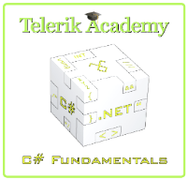
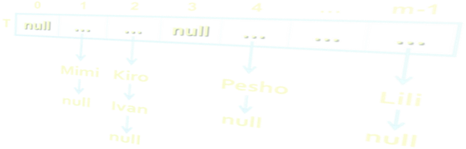
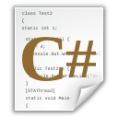
Dictionaries, Hash Tables and Sets
http://academy.telerik.com

Slide 41
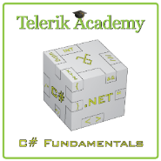



Free Trainings @ Telerik Academy
C# Programming @ Telerik Academy
csharpfundamentals.telerik.com
Telerik Software Academy
academy.telerik.com
Telerik Academy @ Facebook
facebook.com/TelerikAcademy
Telerik Software Academy Forums
forums.academy.telerik.com

